Slide 1








NETWORK SIMULATION PACKETS
TEAM 11

Slide 2

TOPICs
1- packets and security
2-simulate packets
3-simulate attackes
4-implementation

Slide 3
packets
security
A packet is a unit of data that is routed between an origin and a destination on a network. like any file – email, web page, etc. – is sent
Packet size can affect security unusually large or small packets may indicate attacks or suspicious activity.

Slide 4
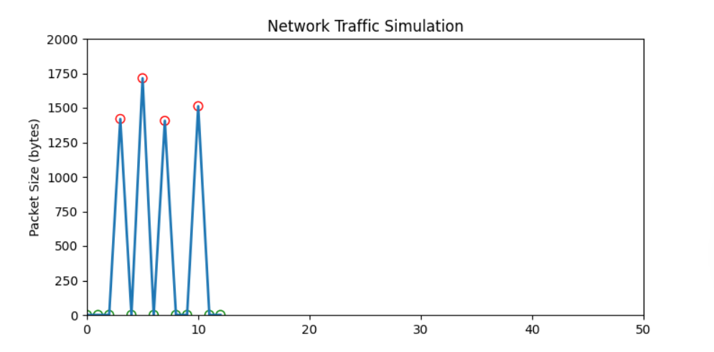
simulate packets

Slide 5
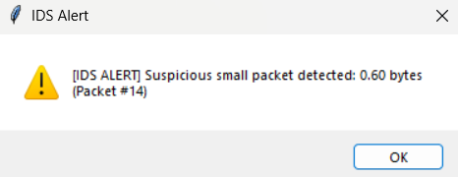
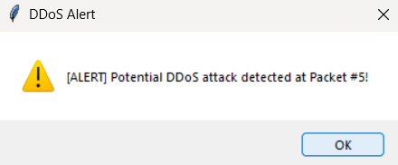
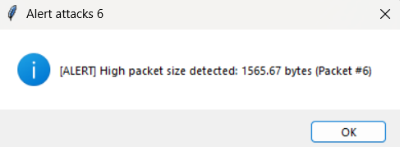
simulate attackes

Slide 6
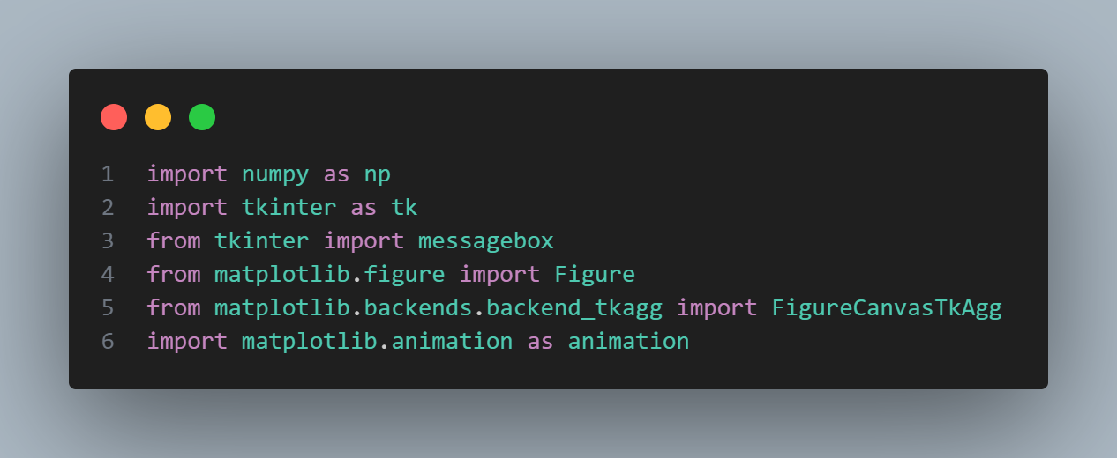
implementation

Slide 7
Team:
Seif eldeen
Zyad deif
seif eleslam
samir mohamed
ahmed yousief
ahmed abo setta
mohamed maher

Slide 8


THE END
if you want any question please ask chat GPT

